Slide 1
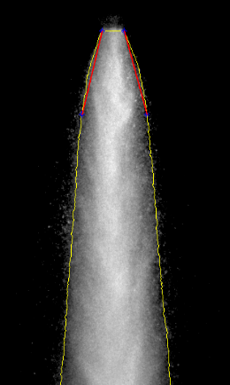
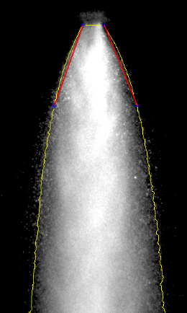
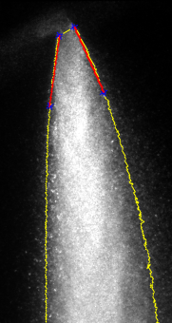
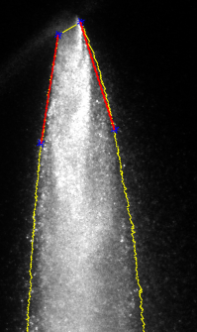
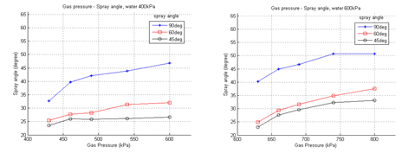
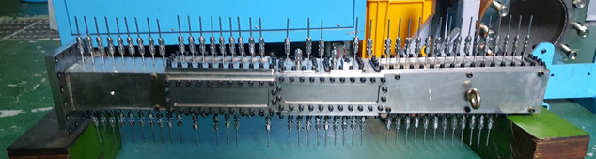
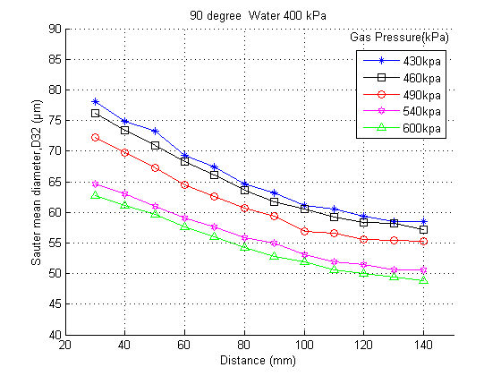
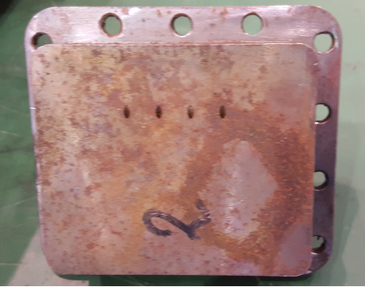
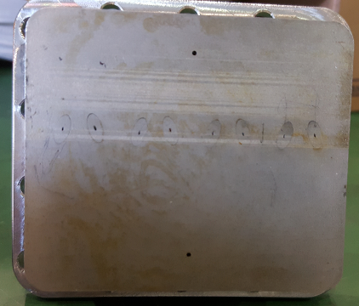
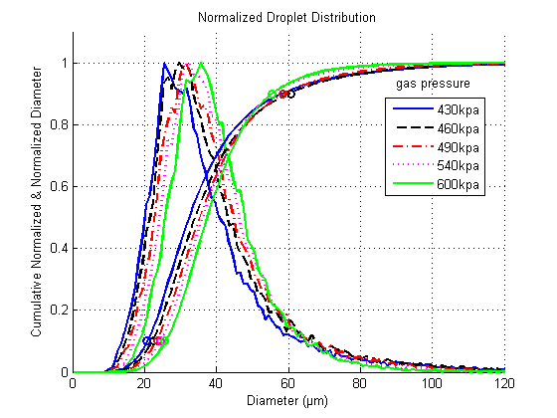
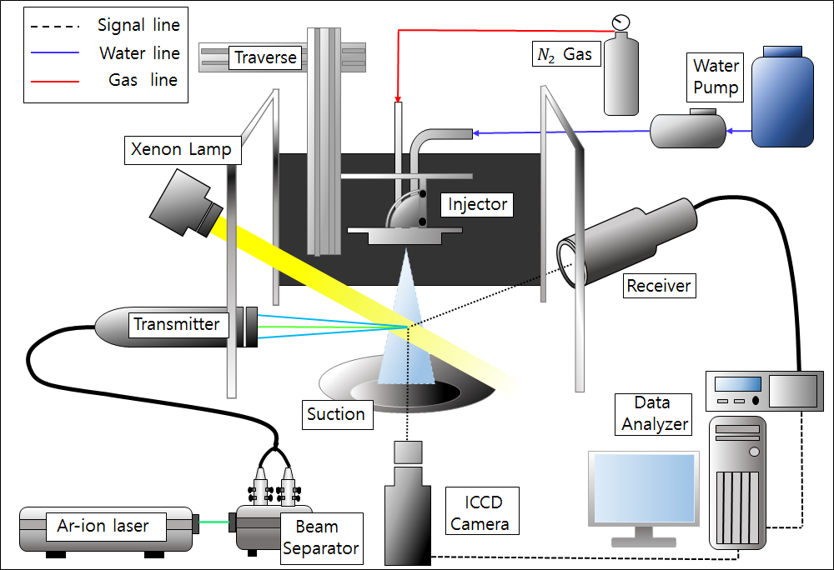
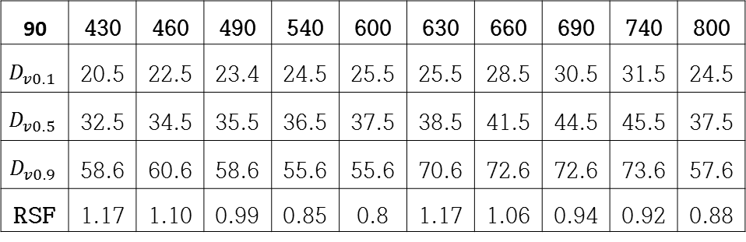
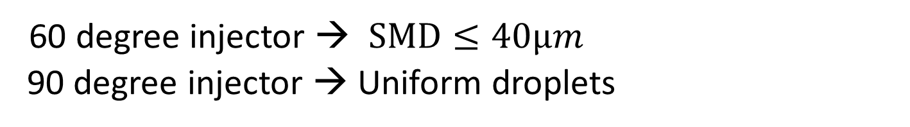
Study on the Spray Characteristic of Airblast type Injector for Scramjet Engine
Jinhee Lee*, Sanghoon Lee**, Kyungjae Lee**, Jaiho Kim**, Sooseok Yang**
*University of Science and Technology
**Korea Aerospace Research Institute
Abstract
As a part of the development procedures of scramjet engine with a regenerative cooling system, visualization and atomization experiments were performed to understand spray characteristics of fuel injectors. To be able to use it for ignition and combustion in a supersonic combustor, this experiments were focus on droplets size and distribution.
Introduction
3. Results
General Scramjet Engine
- Using Hydrogen gas
- Material(Temp.) and storage space issue
Korea Aerospace Research Institute(KARI)
- Scramjet Engine with regenerative cooling system
- Using liquid fuel
Supersonic combustor(Liquid)
- Difficult to ignite and burn
- Atomizing liquid fuel by Injector
Spray characteristics of fuel injector
- Better atomization and combustion
Spray Visualization
Pressure | Water 400kPa |  |  |  |  | Water 600kPa
Gas Pressure (kPa) | 430 | 460 | 490 | 540 | 600 | 630 | 660 | 690 | 740 | 800
Injection angle | Spray angle (degree)
90 degree | 32.7 | 39.7 | 42.1 | 43.9 | 46.9 | 40.2 | 45.0 | 46.7 | 50.7 | 50.8
60 degree | 25.4 | 27.7 | 28.3 | 31.4 | 32.1 | 24.9 | 29.3 | 31.6 | 34.9 | 37.6
45 degree | 23.5 | 26.0 | 25.8 | 26.1 | 26.6 | 23.0 | 27.6 | 29.6 | 32.3 | 33.1
Droplet Size & Distribution
90 | Water 400kPa |  |  |  |  | Water 600kPa
 | 430 | 460 | 490 | 540 | 600 | 630 | 660 | 690 | 740 | 800
D10 | 37.8 | 39.1 | 39.8 | 39.5 | 39.3 | 47.5 | 47.4 | 48.4 | 49.3 | 40.4
SMD | 58.5 | 57.2 | 55.3 | 50.6 | 48.8 | 66.7 | 64.5 | 63.0 | 63.0 | 51.7
2. Experimental Method
 | 60degree Injector |  |  |  |  | 45degree Injector
 | 430 | 460 | 490 | 540 | 600 | 430 | 460 | 490 | 540 | 600
D10 | 25.8 | 26.2 | 26.3 | 25.5 | 25.5 | 32.9 | 33.0 | 31.2 | 32.2 | 30.8
SMD | 48.3 | 46.2 | 43.9 | 37.9 | 34.3 | 56.2 | 56.5 | 47.3 | 48.9 | 47.3
Experimental Instrument
Fuel Injector
- Airblast type Injector
- Impingement type Injector
manufacturing problem
Spray Visualization
- Mie Scattering
PDPA system
Test Condition
90 | 430 | 460 | 490 | 540 | 600 | 630 | 660 | 690 | 740 | 800
$$D_{v0.1}$$ | 20.5 | 22.5 | 23.4 | 24.5 | 25.5 | 25.5 | 28.5 | 30.5 | 31.5 | 24.5
$$D_{v0.5}$$ | 32.5 | 34.5 | 35.5 | 36.5 | 37.5 | 38.5 | 41.5 | 44.5 | 45.5 | 37.5
$$D_{v0.9}$$ | 58.6 | 60.6 | 58.6 | 55.6 | 55.6 | 70.6 | 72.6 | 72.6 | 73.6 | 57.6
RSF | 1.17 | 1.10 | 0.99 | 0.85 | 0.8 | 1.17 | 1.06 | 0.94 | 0.92 | 0.88
PDPA system setup
Transmitter Optics | Channel1 | ChannelⅡ
Wave length (nm) Focal length (mm) Beam separation (mm) Fringe spacing (μm) | 514.5 250 2.65 5.2778 | 488 250 2.65 5.0060
Receiver Optics
Focal length (mm) Slit Aperture (μm) | 250 150
Detectable droplet range | Limit min | Limit max
Diameter (μm) Velocity (m/s) | 0.5 -10.56 | 155.16 121.39
60 degree injector → $SMD≤40μm$
90 degree injector → Uniform droplets
4. Future Plans
1. Combustion test in real scramjet engine model
using airblast type injector
2. Impingement type injector test
Water Pressure (kPa) | 400 kPa
Gas Pressure (kPa) | 430 | 460 | 490 | 540 | 600
GLR (90deg) | 0.0194 | 0.031 | 0.0446 | 0.0816 | 0.1142
GLR (60deg) | 0.0264 | 0.0386 | 0.0569 | 0.1017 | 0.1679
GLR (45deg) | 0.0291 | 0.0415 | 0.0881 | 0.1136 | 0.2245
Water Pressure (kPa) | 600kPa
Gas Pressure (kPa) | 630 | 660 | 690 | 740 | 800
GLR (90deg) | 0.024 | 0.0296 | 0.0443 | 0.065 | 0.0914
GLR (60deg) | 0.0277 | 0.0448 | 0.0542 | 0.1 | 0.1416
GLR (45deg) | 0.0299 | 0.0377 | 0.0627 | 0.0951 | 0.1494
5. Reference
1. Lee, J. H., Lee, S. H., Lee, K. J., Kim, J. H., Yang, S. S., “Study on Spray Visualization and Atomization Characteristics of Air-assist type Injector for Scramjet Engine”, Journal of the Korean Society of Propulsion Engineers, Vol. 21, No. 5, pp. 88-96, 2017.
2017 추계 한국추진공학회 포스터 발표
UST - KARI

